Slide 1
Connecting BRFplus to ABAP
Andreas Gautsch

Slide 2
Content
Short introduction into BRFplus
Connecting BRFplus and ABAP
Example implementation
Discussion
Get a coffee

Slide 3
Content
Short introduction into BRFplus
Connecting BRFplus and ABAP
Example implementation
Discussion
Get a coffee

Slide 4
BRFplus – SAPs rule engine
Targets of rule engines:
Separation of rules and process
Configuration or validation with a “natural language”
Transparent and easy adaptable systems

Slide 5
Target of BRFplus
Minimize custom code and fasten release processes
Even if its not realistic that you get to this state, each step in this direction is mostly worth the effort.
Design
Change custom code
Release
Configure
Business analyst needed
Developer needed

Slide 6
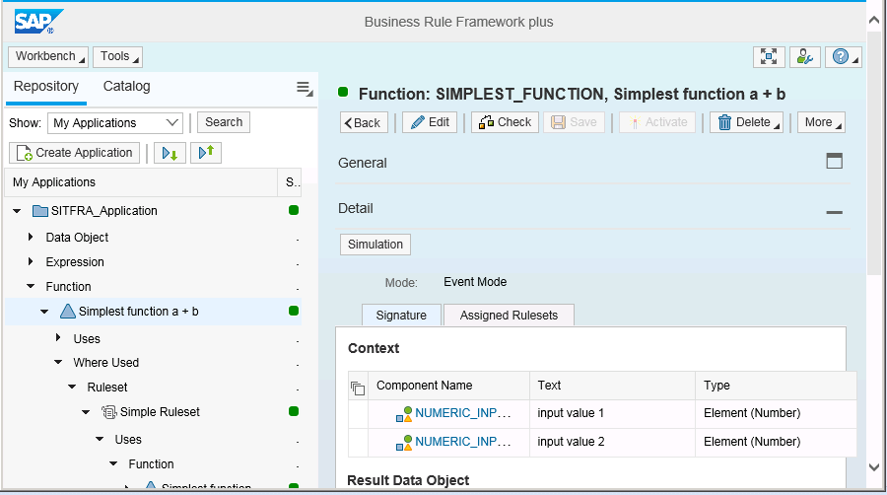
Userinterface of BRFplus
Application
Function
Ruleset
Rule
Transaction: BRFplus

Slide 7
Capabilities of BRFplus
Wide range of numeric and string functions
Usage of ABAP Dictionary elements
Lookup ABAP Database tables
Decision tables with Excel up- and download
Simulation and Tracing
Integration into SAP transport management system
Generation of ABAP code to call BRFplus function

Slide 8
Content
Short introduction into BRFplus
Connecting BRFplus and ABAP
Example implementation
Discussion
Get a coffee

Slide 9
Data exchange of BRFplus and ABAP
ABAP
(Program,
Userexit,
Class, ...)
BRFplus
function
Calling function (with input parameters)
Selecting table entries
Returning result
(any type and exceptions)

Slide 10
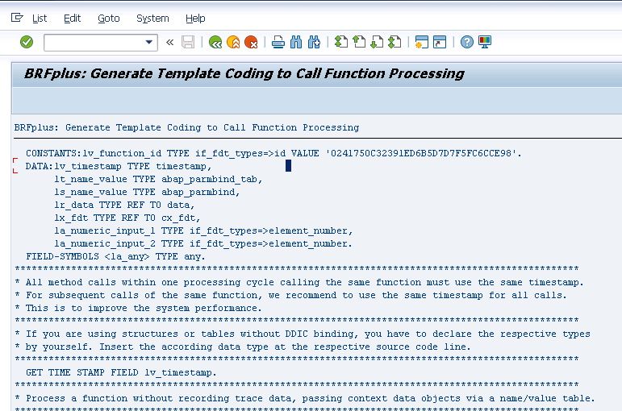
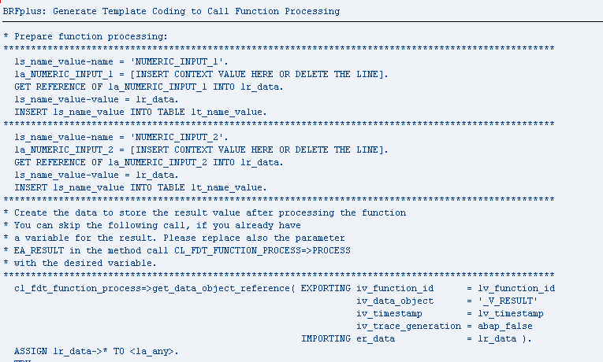
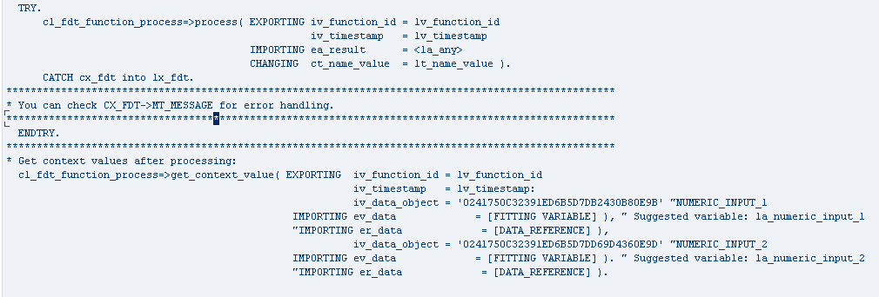
Template for function call
Generation with ABAP report: FDT_TEMPLATE_FUNCTION_PROCESS

Slide 11
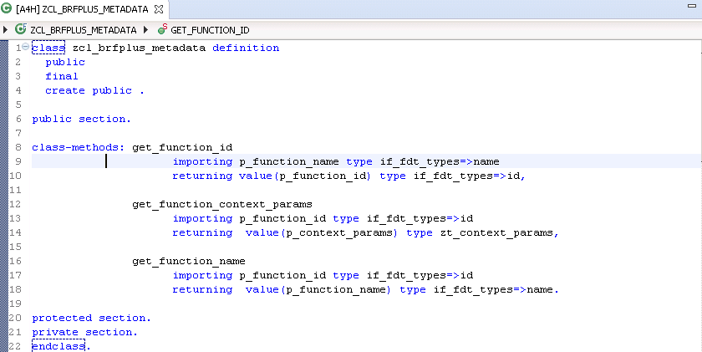
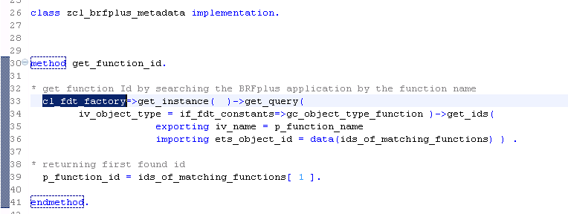
Extraction of function metadata

Slide 12
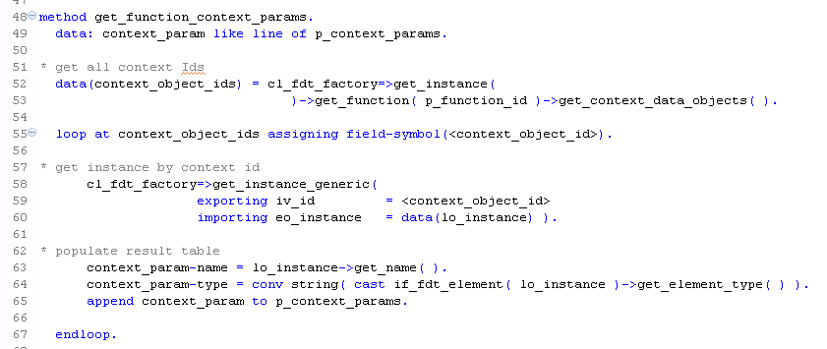
Extraction of context metadata

Slide 13
Content
Short introduction into BRFplus
Connecting BRFplus and ABAP
Example implementation
Discussion
Get a coffee

Slide 14
Sample application – business case
Think of a machine in your production company. This machine has a lot of sensors and modernization continuously comes around to say hello and adds some new sensors. The maintenance people have a status monitor in the SAP ERP system where machine problems together with ERP information (e.g. the needed spare parts and their current location in the storage) are visualized.
→ but to keep it simple lets use a simplified machine

Slide 15
Sample IoT maintenance application
coffee-machine
sensors:
Water
Beans
Trash
SAP ERP
bean suppliers
show due maintenance tasks
Extraction of context data
BRFplus
calculating function
and returning result
Sending sensor data
Calling function
with sensor data
selecting preferred bean supplier
returning tasks with supplier info

Slide 16
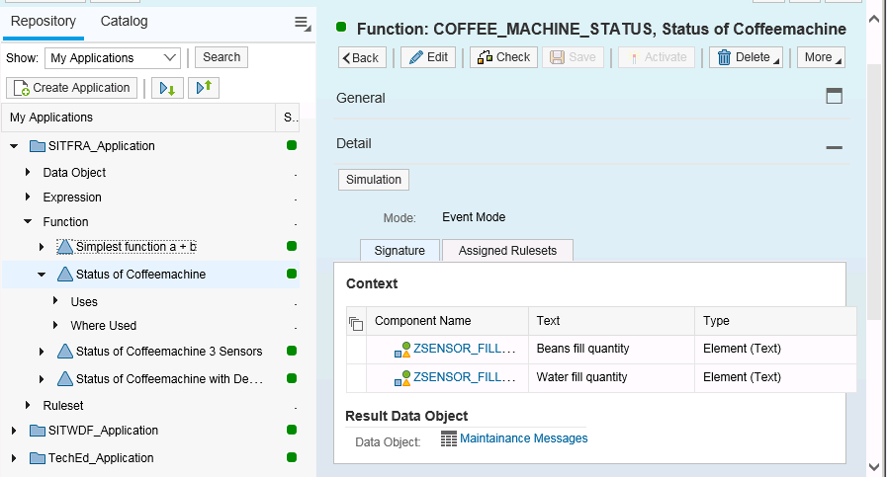
BRFplus function – signature

Slide 17
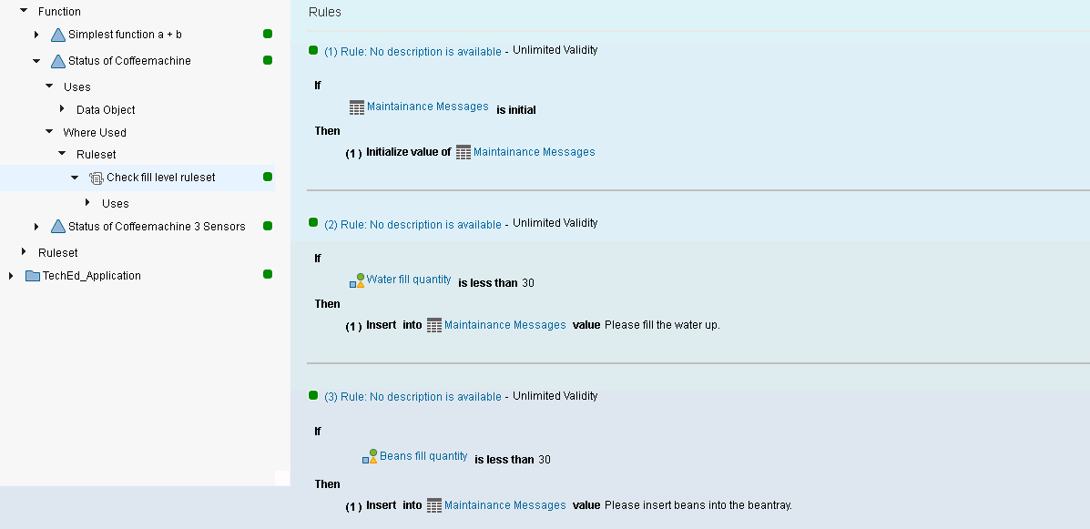
BRFplus function - rules

Slide 18
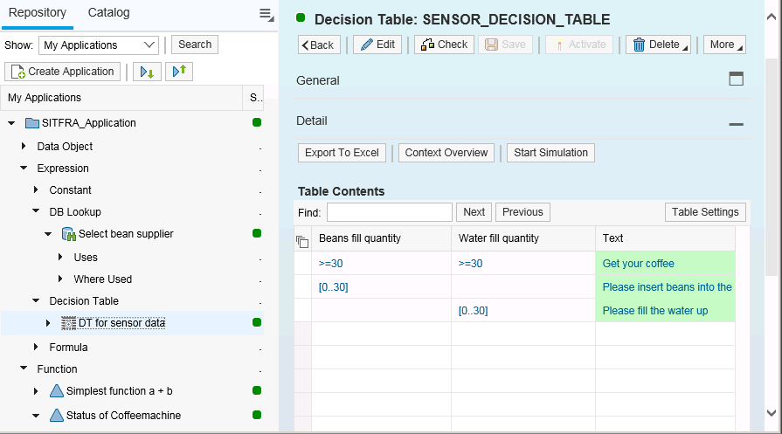
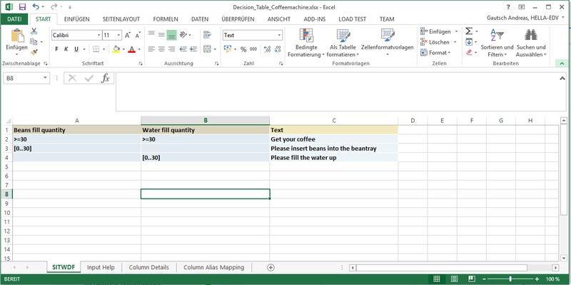
BRFplus function – decision table

Slide 19
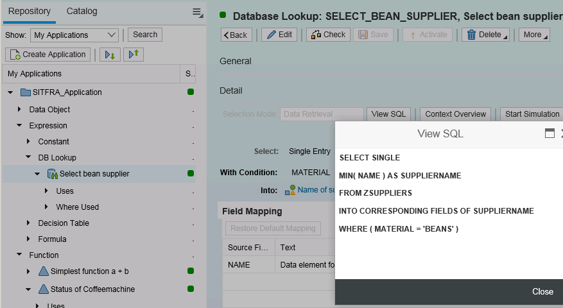
BRFplus function – table access

Slide 20
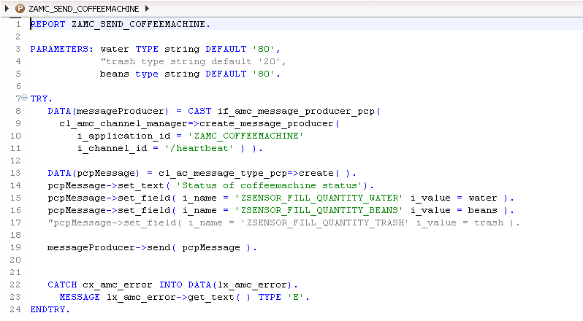
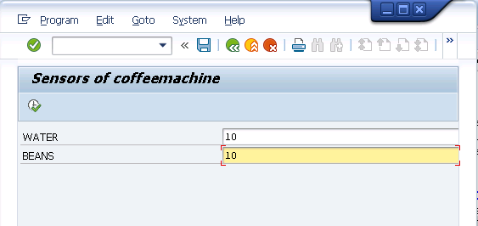
Coffee machine – Digital twin ☺

Slide 21
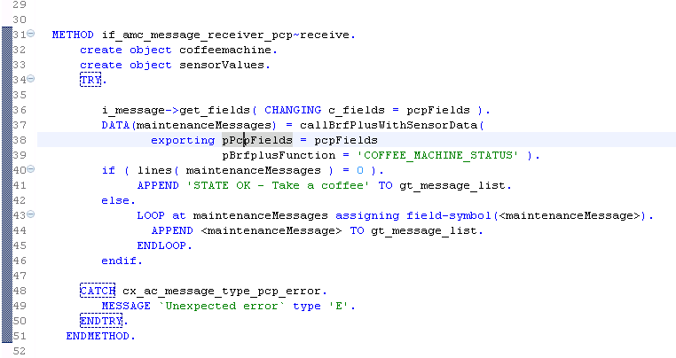
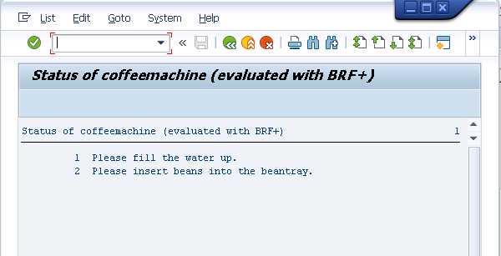
Backend processing of sensor data in ABAP

Slide 22
DEMO

Slide 23
Content
Short introduction into BRFplus
Connecting BRFplus and ABAP
Example implementation
Discussion
Get a coffee

Slide 24
BRFplus – SAPs rule engine
Targets of rule engines:
Separation of rules and process
Configuration or validation with a “natural language”
Transparent and easy adaptable systems
@andreas_gautsch

Slide 25
Appendix – Useful Resources BRFplus
Github Project – Use ABAPGIT from Lars Hvam to download https://github.com/andau/zsitfra
Business Rule Framework – Youtube Video https://www.youtube.com/watch?v=2ouhJeH02HU
Business Rule Framework plus – An example implementation: https://blogs.sap.com/2015/01/29/brf-plus-a-real-time-example/
Business Rule Framework plus C-Level Sales Pitch https://www.sap.com/documents/2015/08/fc926820-577c-0010-82c7-eda71af511fa.html
Book: BRFplus – Business Rule Management for ABAP Applications https://www.sap-press.com/brfplus-business-rule-management-for-abap-applications_2106

